Slide 1

Car accidents in South Moravia
IBM Applied Data Science Capstone project

Slide 2
Introduction Hypotheses Result Discussion Conclusion

Slide 3
Introduction
Brno and South Moravia are the second biggest city and region in Czech Republic
Issue with transposrt
7 thousand registered car accident in 2018
400 thousand inhabitants in Brno
Try to decrease number of car damage, victims of car accidents (injuries or deaths)
Inform travelers threats of danger on roads

Slide 4
Hypotheses
Which area has a higher possibility of a car accident?
What time and date have those area higher possibility of a car accident?

Slide 5
Results
Statistically we can said that during year 2018 in South Moravia were 3187 car accidents. From that 42 persons died. Heavy Injuries have 291 persons. Light Injuries has 2514 people. The damage was calculated as 181.095.100 CZK (around 8 146 795 USD) meaning that each car accident has damage around 3.000 CZK (135 USD).
The most car accidents were during the week high except Saturday and Sunday, as it is visualized in bar graph below. As hypothesis was told to predict time and date, this hypothesis cannot be answer, as on the market there are no data source collecting time.

Slide 6
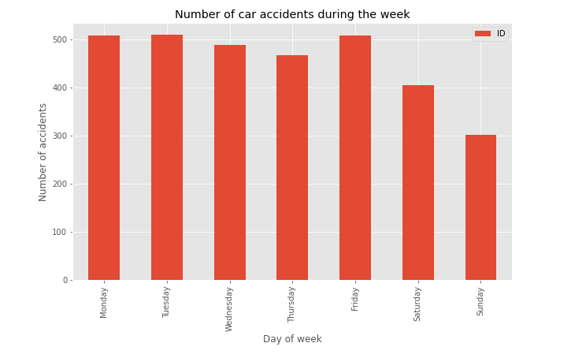
The most car accidents were during the week high except Saturday and Sunday, as it is visualized in bar graph below. As hypothesis was told to predict time and date, this hypothesis cannot be answer, as on the market there are no data source collecting time.

Slide 7
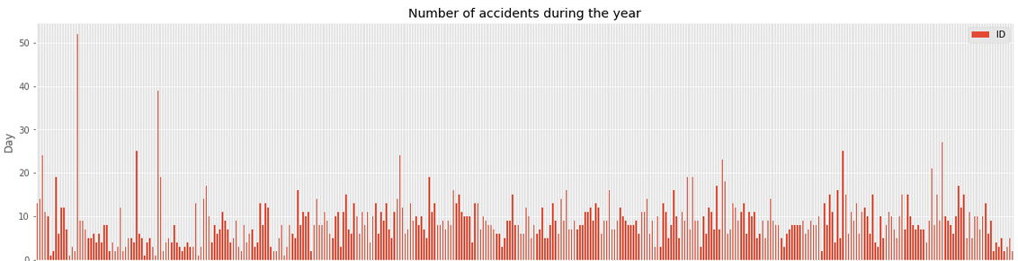
As date we can say that during February and March is lower change to have car accident that in other Month of year.

Slide 8
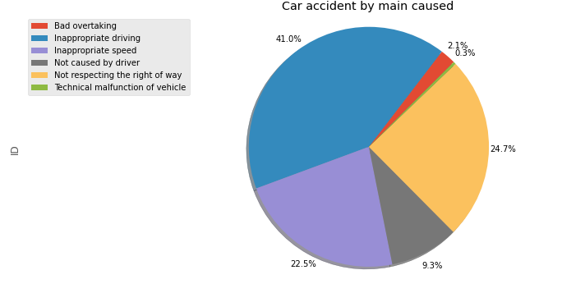
The main reason for car accident were inappropriate driving or inappropriate speed.

Slide 9
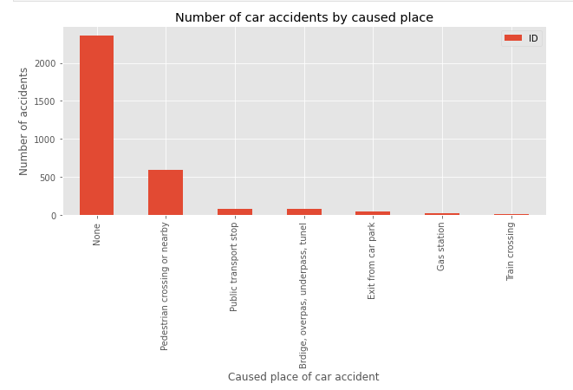
Caused place of accident was usually not reported. The main contributor otherwise is pedestrian crossing or nearby. Others are transport stops, bridges, overpass or underpass.

Slide 10
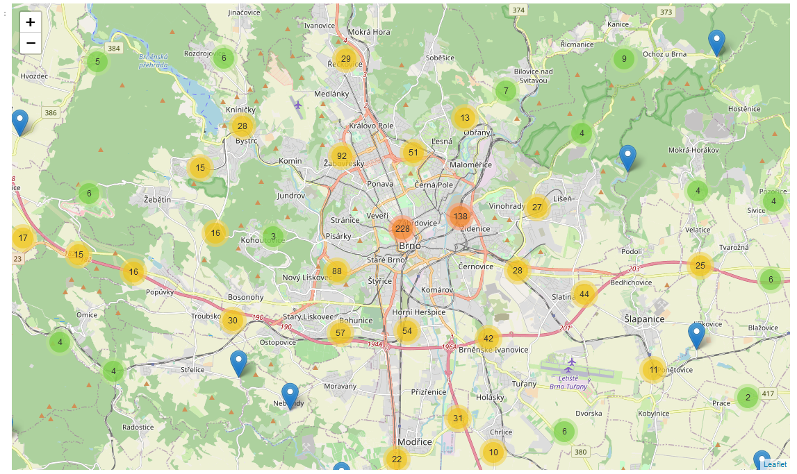
In the map is easy demonstrated the value of higher risk accidents place.

Slide 11
Discussion
Based on my skills I think I did maximum for this project. However I see the opportunity to make much bigger conclusion based on those data. If those data will used much in more details, it could possibly help to save lives, health or damage.

Slide 12
Conclusion
The risk of the car accident is mainly at the center of Brno city and highways. The lower risk/chance to have car accident is on Saturday and Sunday and in February and March.
In the next contribution on this project could possibly be the deep analyzing and prediction data for better understating and exact highlighted place of car accident (generally we can say be aware of pedestrian crossing and around, but would be much helpful to target on those one, which could possibly lead to crash or death.

Slide 13
Thank you !

